Slide 1


Capstone Project
Flower Image Classification
Neel Deorukhkar
Thanks to Springboard Mentor
Bernard Chan,
Kabam

Slide 2

The Problem
A Flower shop faces from a low labor shortage and high incoming customer traffic
The business owners wants to automate manual tasks performed by the florist so that the time can better be used for more useful tasks such as watering the plants in the nursery
Customers upload photos of the flowers to the flower’s website, and the florist manually classifies the images
The business owner wants a consulting firm to automate this task

Slide 3
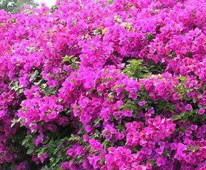
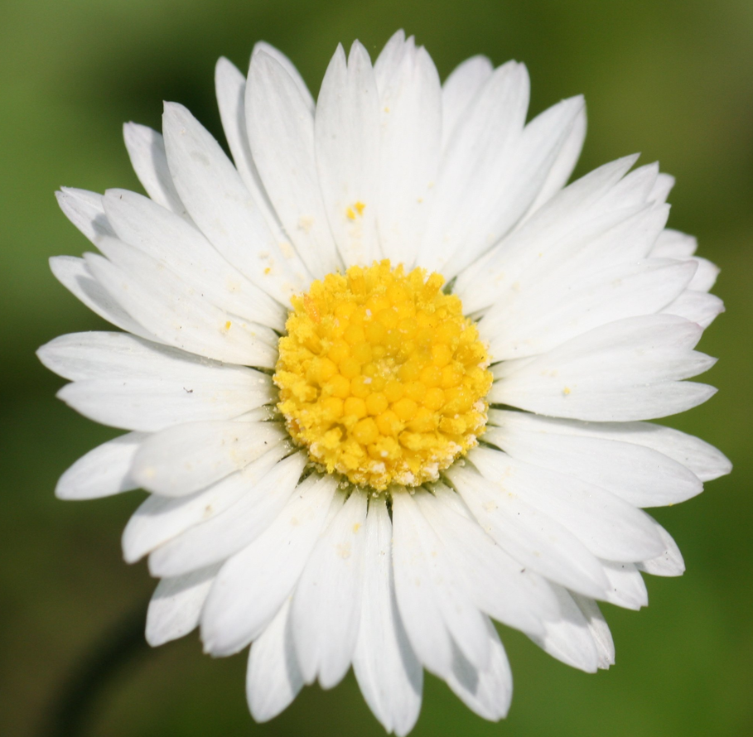
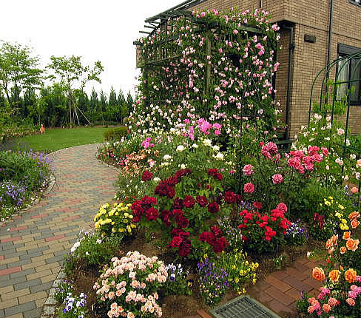
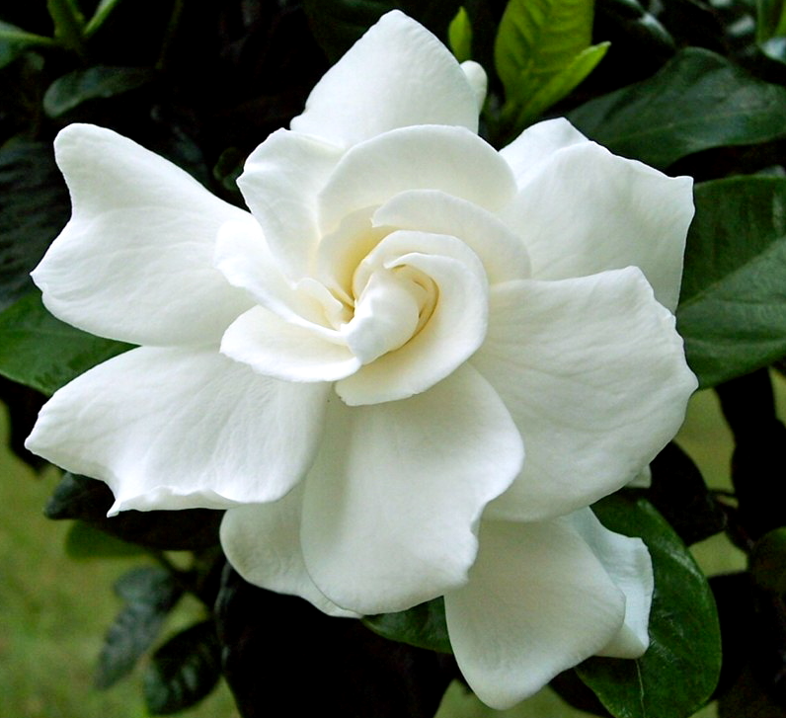
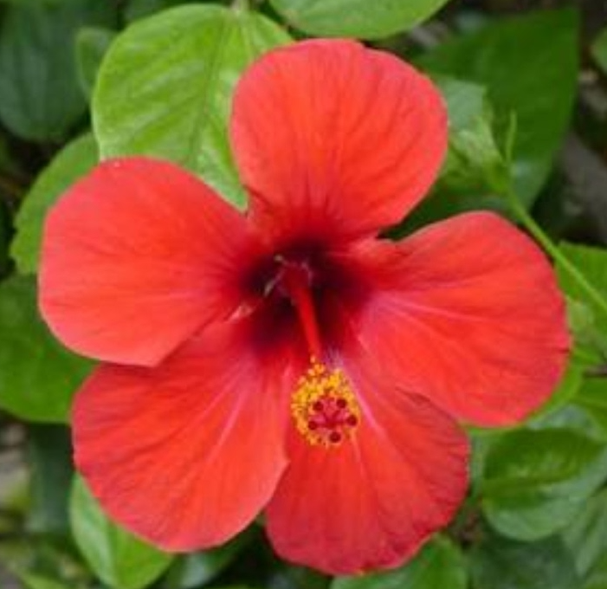
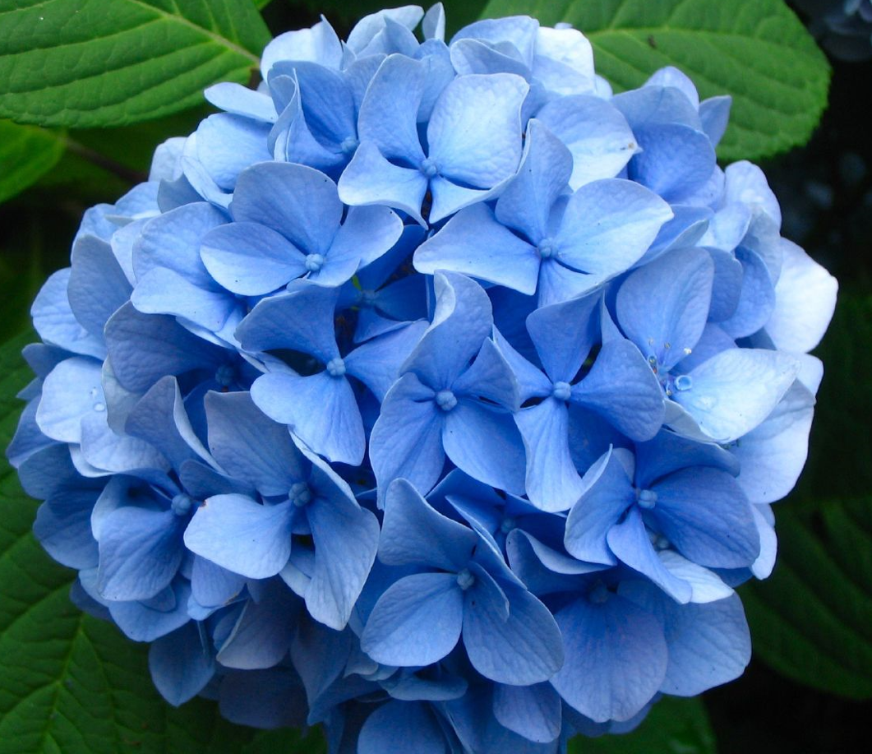
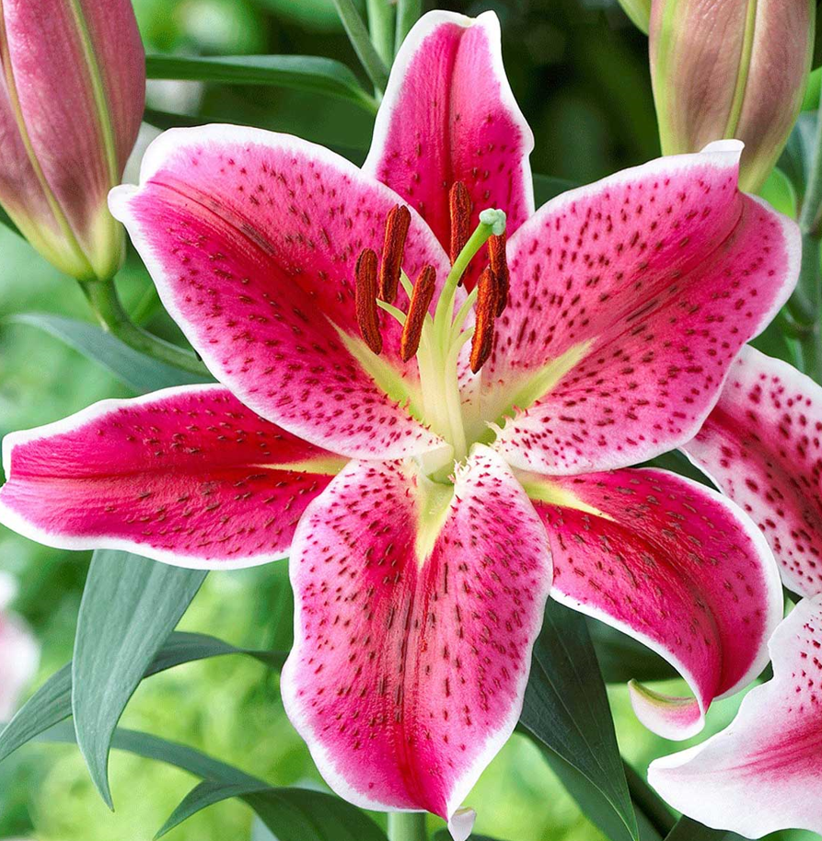
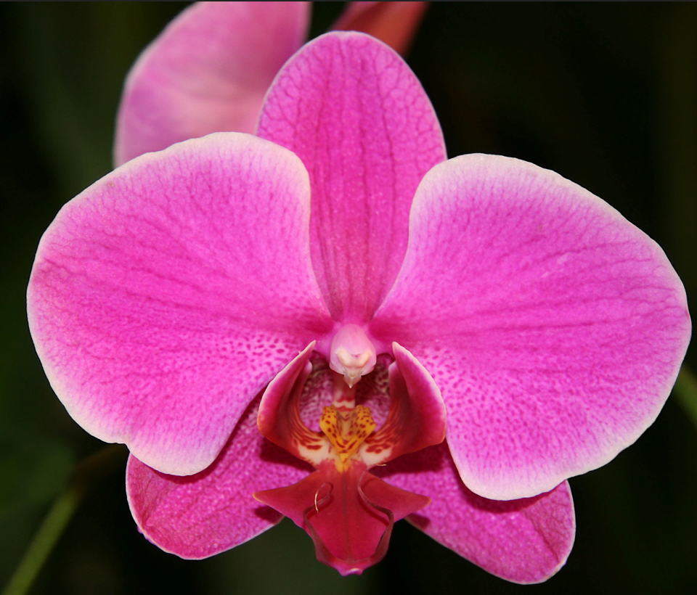
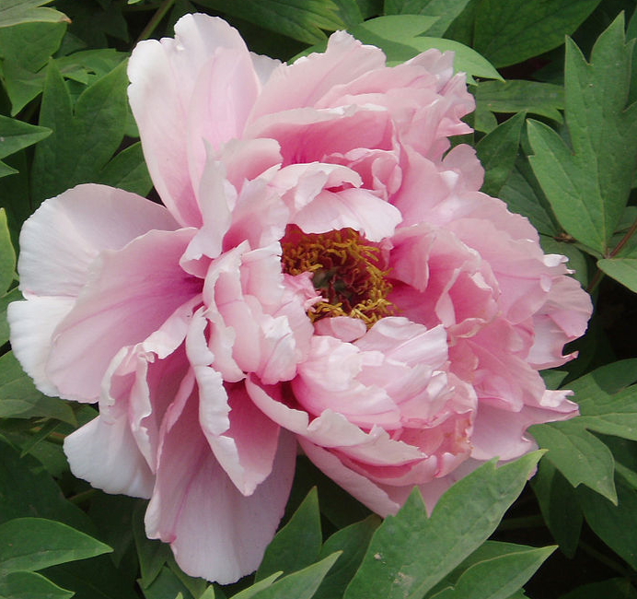

The Data
733 input images / 10 Classes
bougainvillea
Daisies
Garden Roses
Gardenia
Hibiscus
hydrangeas
Lilies
Orchids
Peonies
Tulips

Slide 4

Success
Build a Deep Learning model that can predict customer images with at least 85% accuracy
The florist can easy spot misclassified flowers based on the file names and manually change the names
By doing so, the owner still reduces the time from 100% of the florist’s time to 15% of the florists time
The savings lead to a 90% increase in ROI

Slide 5
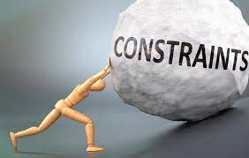
Constraints
Number of training images is small
Reliance on third party data
Model accuracy not close enough to human accuracy of 100%

Slide 6
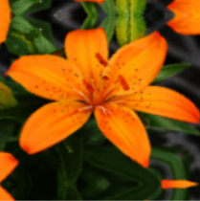
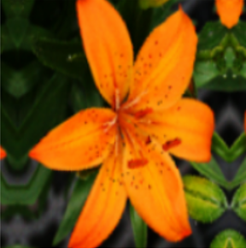
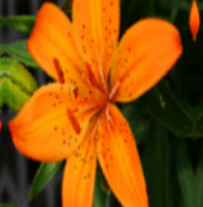
Data Augmentation
We can increase the size of the training dataset by randomly flipping, rotating and zooming into the images
Random Flip
Random Rotate
Random Zoom

Slide 7

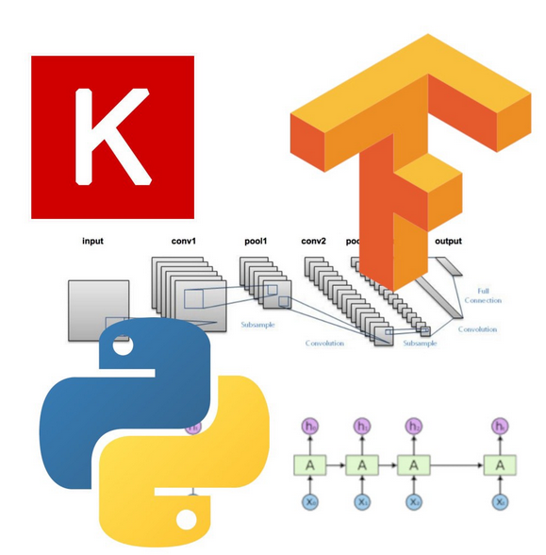



Approach to solve the problem
Implement a Convolutional Neural Network
Use the Keras Sequential API to build the network
Augment the Data
Tune the model to reduce overfitting
Test Pretrained models

Slide 8
Base Model Architecture
The base model architecture consists of 3 convolutional layers, each with an increasing number of filters
Each convolutional layer consists of a Conv2D layer followed by batch normalization that standardizes the inputs for each mini batch
The padding is set as ‘same’ to preserve the input shape
The batch normalization is followed by a ReLu (Rectified Linear Unit) activation
The Relu activation is followed by a Max Pool 2D layer
The number of filters in each layer increases from 64 to 128 to 256 followed by reducing the pool sizes from 8 to 4 to 2 in the Max Pool Layer.

Slide 9
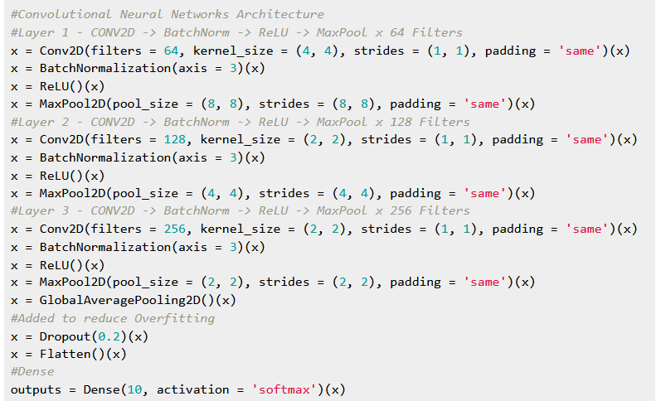
Base Model Code

Slide 10
Model Specifications
Hyper parameter | Value | Notes
Optimizer | Adam | Most popular optimizer used
Epochs | 70 | Global Optimum can be achieved
Batch Size | 32 | Each Epoch runs Faster
Loss | Sparse Categorical Cross Entropy | Used for Multi Class Classification
Callbacks | EarlyStopping Patience = 25 | Helps reduce processing time

Slide 11
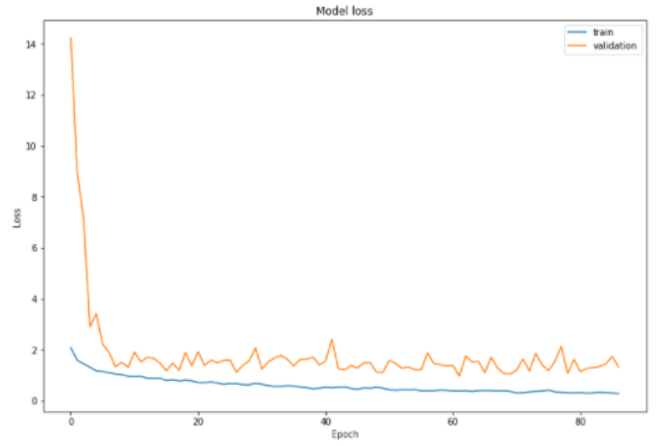
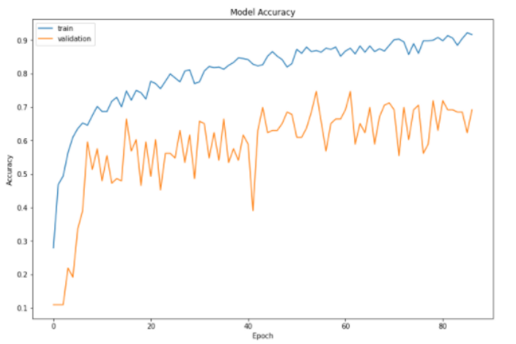
Base Model Performance
The base model overfits the validation data set since the training accuracy is 98% and the validation accuracy is 70%. The validation loss is 1.32.

Slide 12
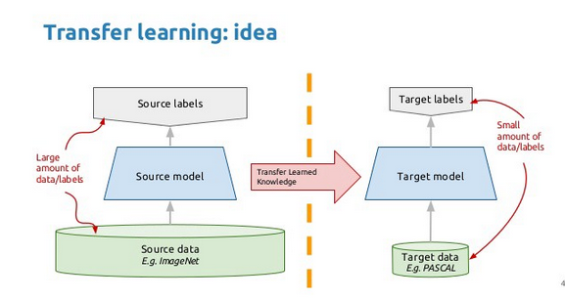
Transfer Learning
We can use a network trained on unrelated categories in a massive dataset (ImageNet) and apply it to our problem. Some of the examples of popular frameworks are mentioned below:
Mobile Net V2
VGG 16
ResNet50

Slide 13
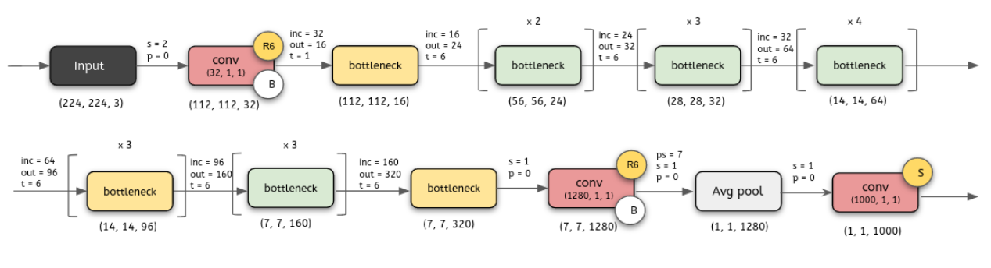
Mobile Net V2
The MobileNetV2 is a pretrained model that uses pretrained weights from ImageNet. The original model predicts 1000 classes. However, the dataset that we are working with consists of only 10 classes. As a result, we can drop the top layer, and include a Dense layer of 10 classes with a ‘softmax’ activation function.

Slide 14
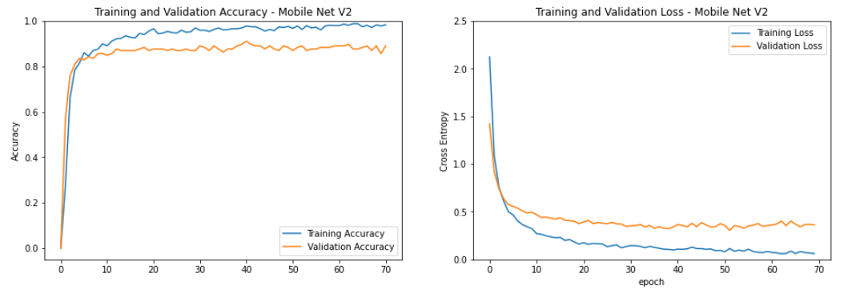
Mobile Net V2 Performance
The Mobile Net V2 model does not overfit the validation data set since the training accuracy is 98% and the validation accuracy is 89%. The validation loss too has improved to 0.35
Furthermore, the time per epoch is only 300 ms.

Slide 15
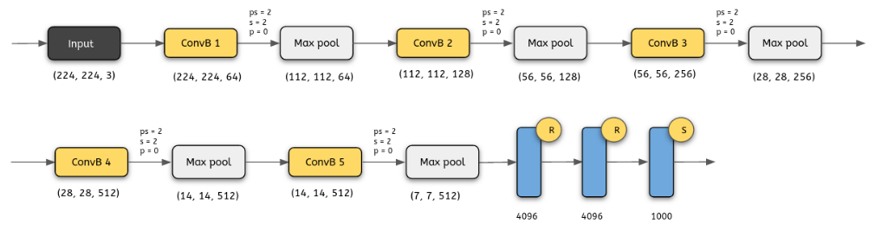
VGG 16
The VGG16 model is much slower than the MobileNetV2 model because of the size of the network and number of parameters.
Secondly, the model predicts better than the base model but much more poorly than the MobileNetV2 model.

Slide 16
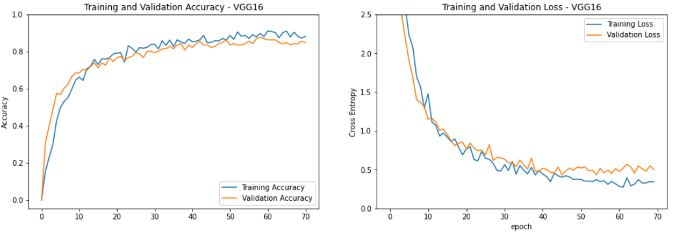
VGG 16 Performance
The VGG-16 model does not overfit the data but has a high bias since the training accuracy is 88% and the validation accuracy is 85%. The validation loss too has improved to 0.50

Slide 17
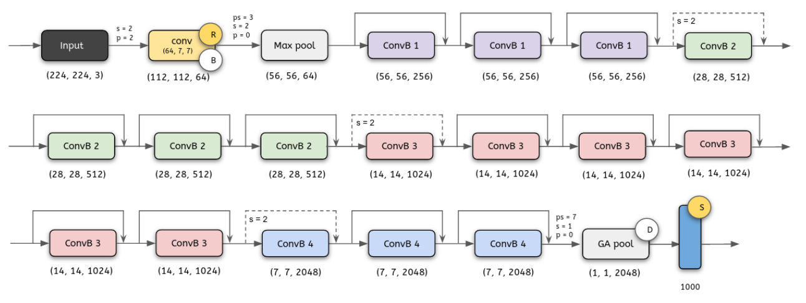
ResNet50
The Resnet50 model does better than the base model and VGG16 model.
This is pretty good, but the Mobile V2 Model is the best in terms of accuracy and lowest validation loss.

Slide 18
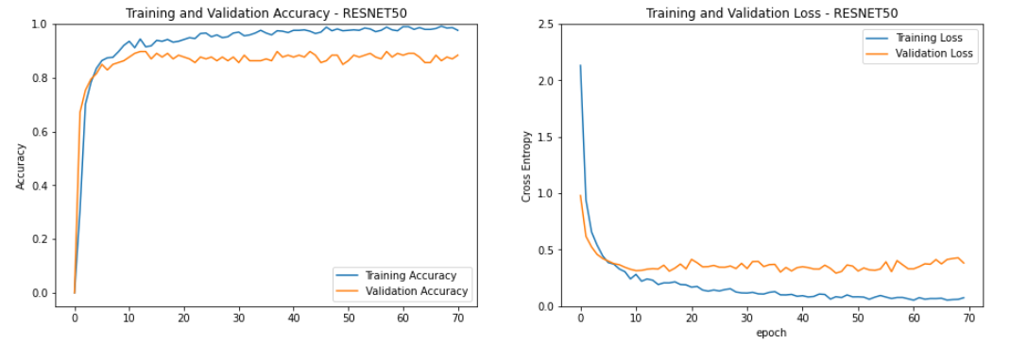
ResNet50 Performance
The Resnet50 model does not overfit the data since the training accuracy is 97% and the validation accuracy is 88%. The validation loss too has improved to 0.38

Slide 19
Modeling Summary
Mobile Net V2 trains the quickest, has the highest validation accuracy and lowest validation loss
Model | Training Accuracy | Validation Accuracy | Loss | Time Per Epoch
Base Model | 98% | 70% | 1.32 | 500ms
Mobile Net v2 | 99% | 89% | 0.35 | 350ms
VGG 16 | 96% | 85% | 0.50 | 34s
ResNet50 | 96% | 88% | 0.38 | 750ms

Slide 20
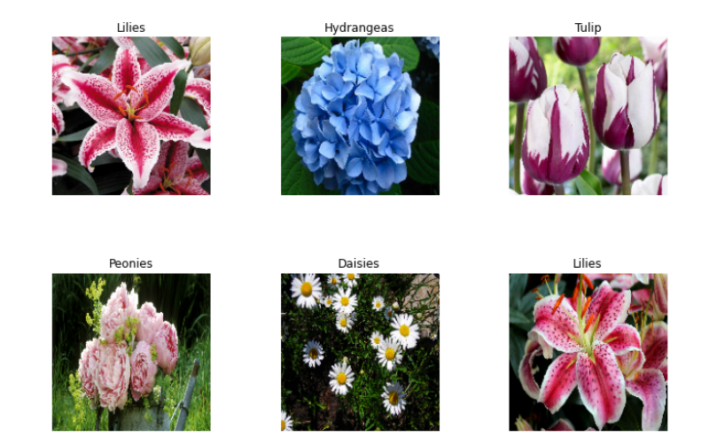
Model Predictions
Now that we’ve finalized the Mobile Net v2 model, we can apply the model to predict the images from the validation dataset.
As you can see here, the model does a good job classifying the validation dataset

Slide 21
Recommendations and Next Steps
The Flower shop can use the image classification model to predict customer images
Deep learning can not only be used for Flower classifications but in other avenues such as making recommendations to customers on the website
1st party Website visits and clicks can be used to gain insights into what bouquets are selling the best and who is the target audience
Subsequently, audience targeting can be done using tactful ad placements to generate a higher ROI

Slide 22
Thank you!

